Slide 1
WANDER LUST : A PERSONALISED
TRAVEL PLANNING AND TRACKING APP

Slide 2
OBJECTIVES
Promote tourism with well-planned one-week city itineraries.
Simplify travel planning by offering personalized suggestions.
Enhance travel experiences with cultural and real-time insights.

Slide 3
DESCRIPTION
An app that suggests cities to visit and provides detailed one-week travel plans, including itineraries,
costs, and booking options. It adapts to user
preferences, budgets, and real-time changes to ensure an enjoyable travel experience.

Slide 4
FUNCTIONALITIES
City Suggestions: Recommend cities based on budget and interests.
Pre-Made Itineraries: Offer one-week travel plans with activities.
Personalization: Filter plans by budget, group size,
and travel style.
Cultural Insights: Provide tips, customs, and local events.
User Reviews: Share and rate experiences.
Offline Access: View itineraries without internet.
Budget Tracker: Estimate and manage travel costs.

Slide 5
ADDITIONAL REQUIREMENTS
Technical: Offline access for all features.
Design: Intuitive, user-friendly interface.
Monetization: Completely free to use.

Slide 6
Main Activity.kt:
Package com.example.travelapp Import android.content.Context Import android.content.Intent Import android.os.Bundle
Import androidx.activity.ComponentActivity Import androidx.activity.compose.setContent Import androidx.compose.foundation.Image Import androidx.compose.foundation.clickable Import androidx.compose.foundation.layout.*
Import androidx.compose.foundation.rememberScrollState Import androidx.compose.foundation.verticalScroll
Import androidx.compose.material.Card
Import androidx.compose.material.Text
Import androidx.compose.runtime.Composable Import androidx.compose.ui.Alignment
Import androidx.compose.ui.Modifier
Import androidx.compose.ui.draw.scale Import androidx.compose.ui.graphics.Color
Import androidx.compose.ui.res.painterResource
Import androidx.compose.ui.res.stringResource Import androidx.compose.ui.text.font.FontFamily Import androidx.compose.ui.text.font.FontWeight Import androidx.compose.ui.text.style.TextAlign

Slide 7
Class MainActivity : ComponentActivity() {
Override fun onCreate(savedInstanceState: Bundle?) {
Super.onCreate(savedInstanceState)
setContent { TravelApp(this)
}
}
@Composable
Fun TravelApp(context: Context) { Column(
Modifier = Modifier
.padding(20.dp)
.verticalScroll(rememberScrollState())
) {
Text(
fontSize = 40.sp,
color = Color(android.graphics.Color.rgb(120, 40, 251)), fontFamily = FontFamily.Cursive,
text = “Wanderlust Travel”

Slide 8
Spacer(modifier = Modifier.height(20.dp))
// 01
Card(
Modifier = Modifier
.fillMaxWidth()
.height(250.dp)
.clickable { Context.startActivity(
Intent(context, BaliActivity::class.java)
)},
Elevation = 8.dp )
{
Column(
horizontalAlignment = Alignment.CenterHorizontally
) {
Image(
painterResource(id = R.drawable.bali), contentDescription = “”,
modifier = Modifier
.height(150.dp)

Slide 9
.scale(scaleX = 1.2F, scaleY = 1F)
)
Text(
Text = stringResource(id = R.string.place_1), fontSize = 18.sp
)
Text(
Text = stringResource(id = R.string.description),
fontWeight = FontWeight.Light,
fontSize = 16.sp,
textAlign = TextAlign.Center,
)
Text(
Text = stringResource(id = R.string.plan), color = Color.Gray, fontSize = 16.sp
)
}
}
Spacer(modifier = Modifier.height(20.dp))

Slide 10
Card(
Modifier = Modifier
.fillMaxWidth()
.height(250.dp)
.clickable { Context.startActivity(
Intent(context, ParisActivity::class.java)
) },
Elevation = 8.dp
) {
Column(
horizontalAlignment = Alignment.CenterHorizontally
) {
Image(
painterResource(id = R.drawable.paris), contentDescription = “”,
modifier = Modifier
.height(150.dp)
.scale(scaleX = 1.2F, scaleY = 1F)
)

Slide 11
Text(
Text = stringResource(id = R.string.place_2), fontSize = 18.sp
)
Text(
Text = stringResource(id = R.string.description),
fontWeight = FontWeight.Light,
fontSize = 16.sp,
textAlign = TextAlign.Center,
)
Text(
Text = stringResource(id = R.string.plan), color = Color.Gray, fontSize = 16.sp
)
}
}
Spacer(modifier = Modifier.height(20.dp))

Slide 12
Card(
Modifier = Modifier
.fillMaxWidth()
.height(250.dp)
.clickable { Context.startActivity(
Intent(context, SingaporeActivity::class.java)
) },
Elevation = 8.dp
) {
Column(
horizontalAlignment = Alignment.CenterHorizontally
) {
Image(
painterResource(id = R.drawable.singapore), contentDescription = “”,
modifier = Modifier
.height(150.dp)
.scale(scaleX = 1.2F, scaleY = 1F)
)

Slide 13
Text(
Text = stringResource(id = R.string.place_3), fontSize = 18.sp
)
Text(
Text = stringResource(id = R.string.description), fontWeight = FontWeight.Light,
fontSize = 16.sp,
textAlign = TextAlign.Center,
)
Text(
Text = stringResource(id = R.string.plan), color = Color.Gray, fontSize = 16.sp
)}
}
Spacer(modifier = Modifier.height(20.dp))
}
}
}

Slide 14
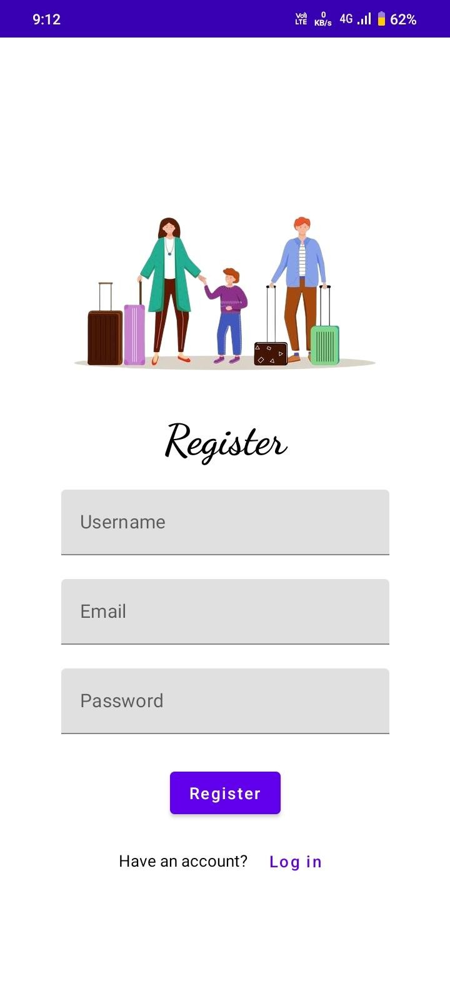
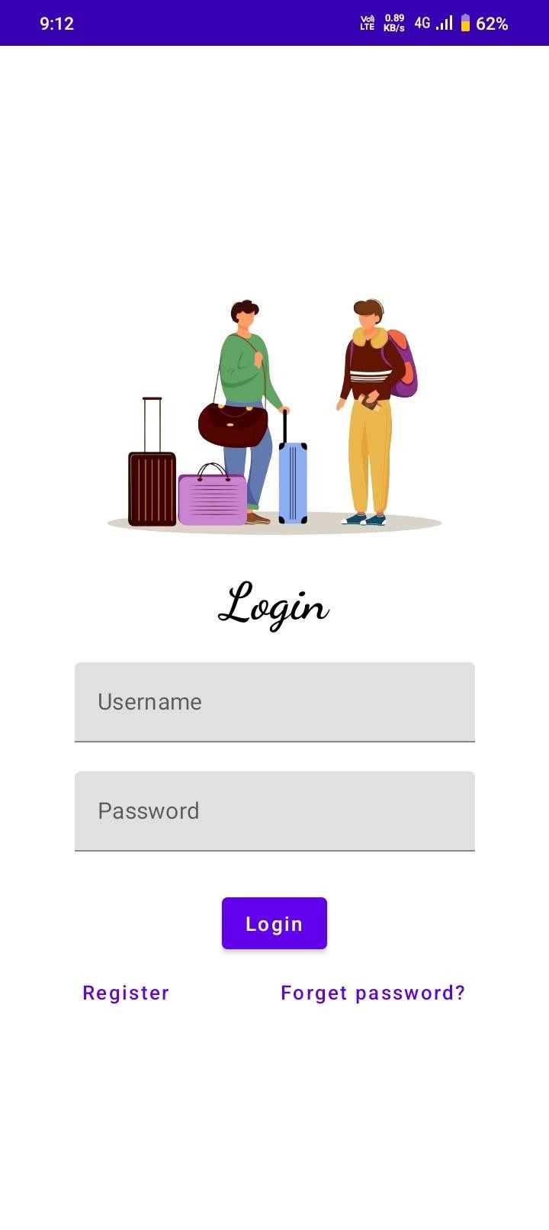
OUTPUT :

Slide 15
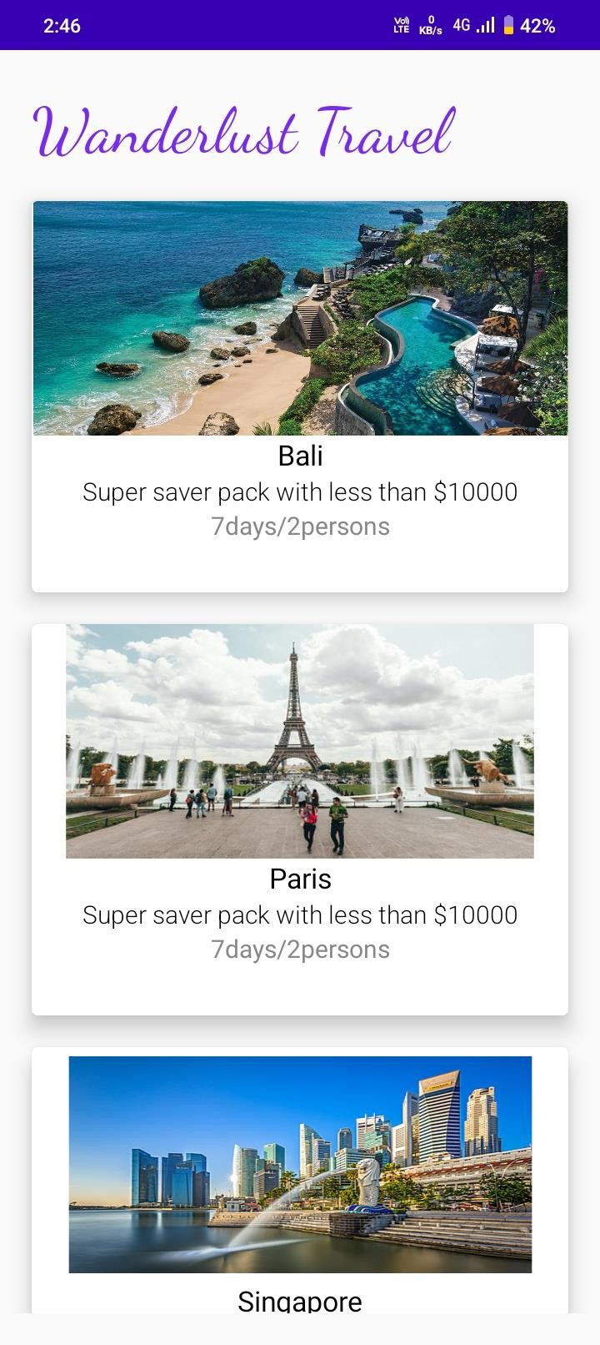
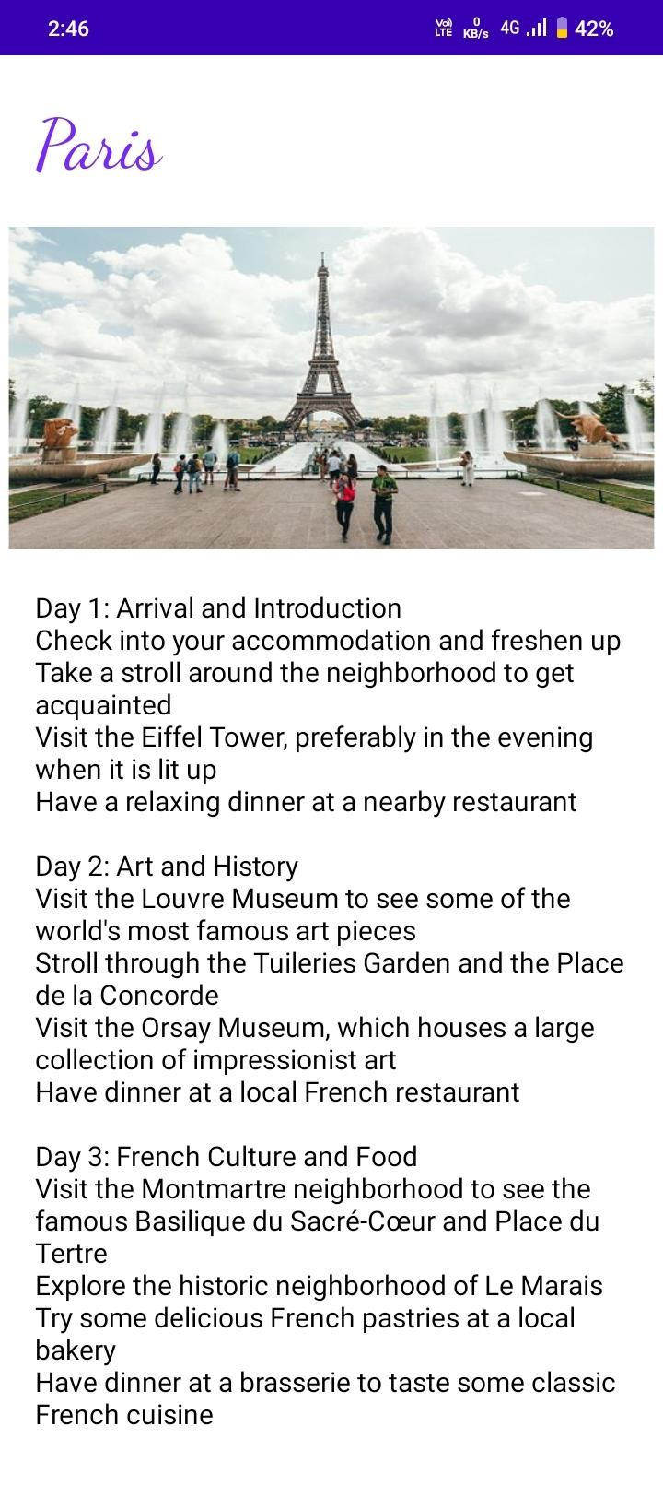

Slide 16
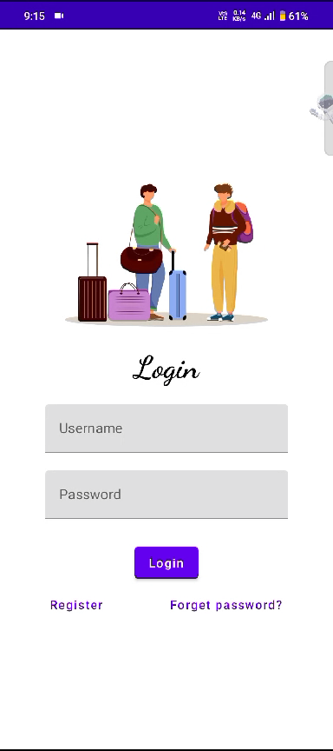
Output video:

